Slide 1

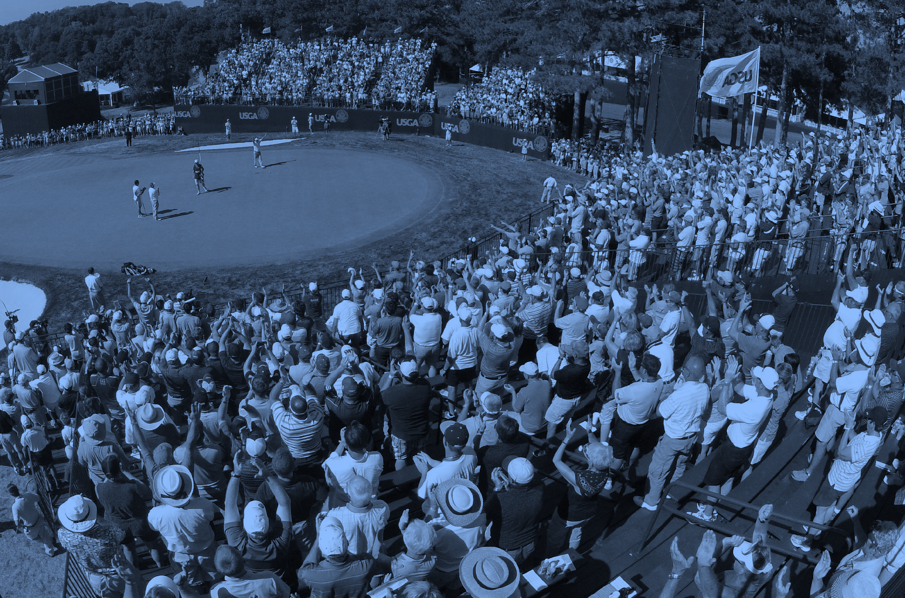

Social Media Results
May 2022
dudzicMEDIA

Slide 2
THE STRATEGY
TOOLKIT
INFLUENCER OUTREACH
Social-first website that hosts content for individuals or businesses to easily amplify via social media channels.
Generate Identify and pitch local influencers to share content leading up to the championship.
Design an organic social media strategy to position the U.S. Senior Open as one of the Lehigh Valley’s premier events in 2022.
PLAYER CAMPAIGN
CONTENT
Activate local students (college + HS) to engage with senior golfers on social media encouraging participation and generate buzz around the event. Campaign expanded April 2022 to include volunteers.
Design content that highlights local region, news, promotes ticket sales, player qualifications and downloadable assets for sponsors.

Slide 3
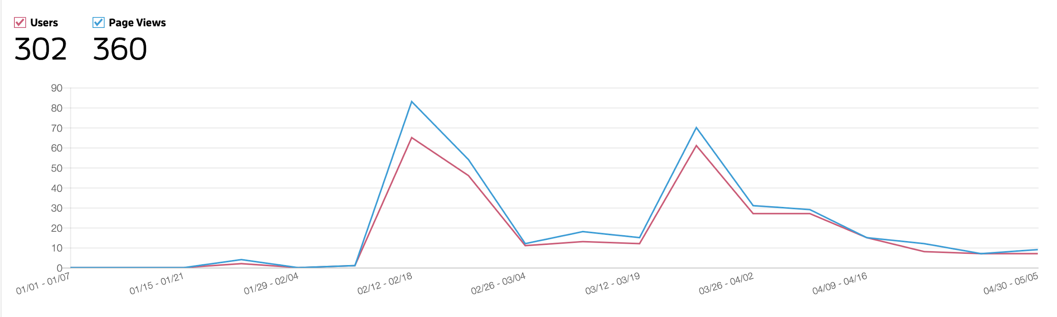
RESULTS
TOOLKIT
TOOLKIT VIEWS
REACH
The toolkit resulted in 360 total page views by 302 individual users.
SOCIAL SHARES
29 total posts shared from the toolkit:
15 Facebook
11 Instagram
2 Twitter
1 LinkedIn
ASSET DOWNLOADS
79 total downloads of event images or promotional video

Slide 4
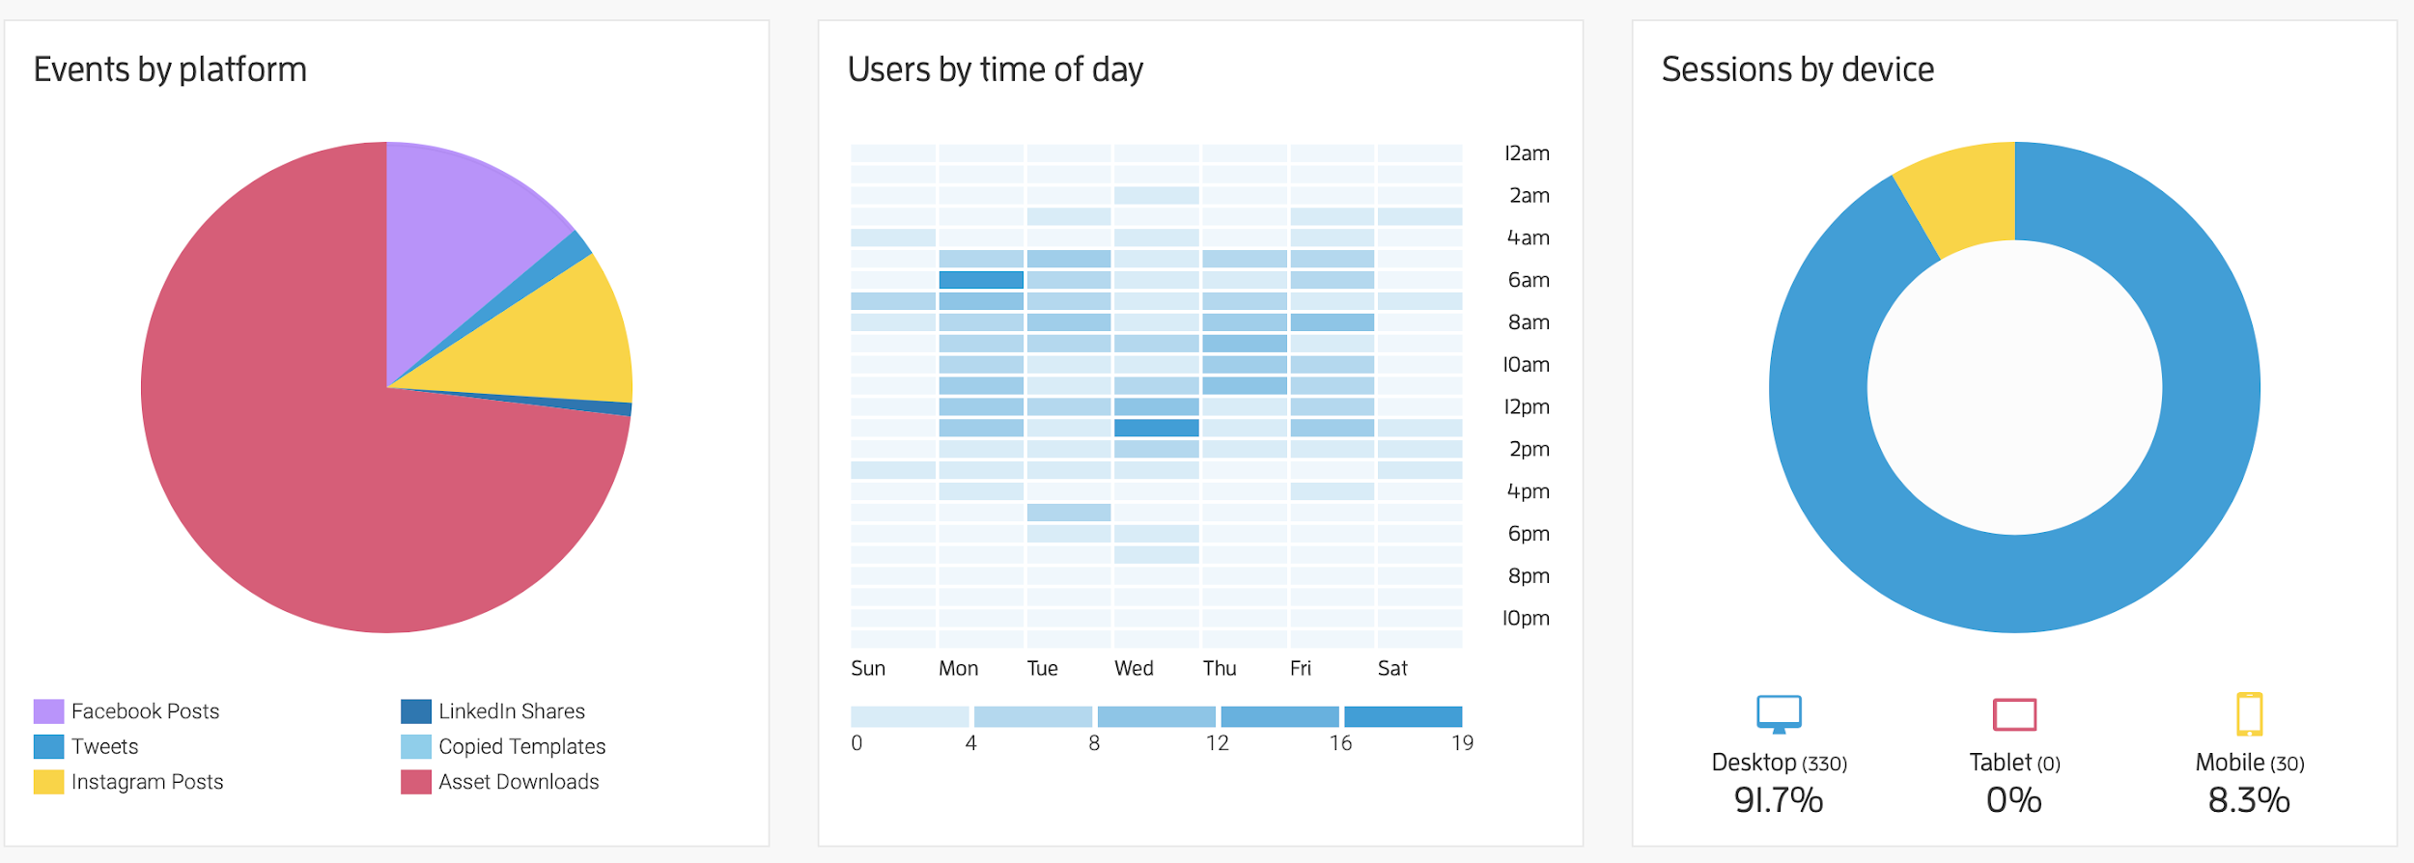
RESULTS
TOOLKIT

Slide 5


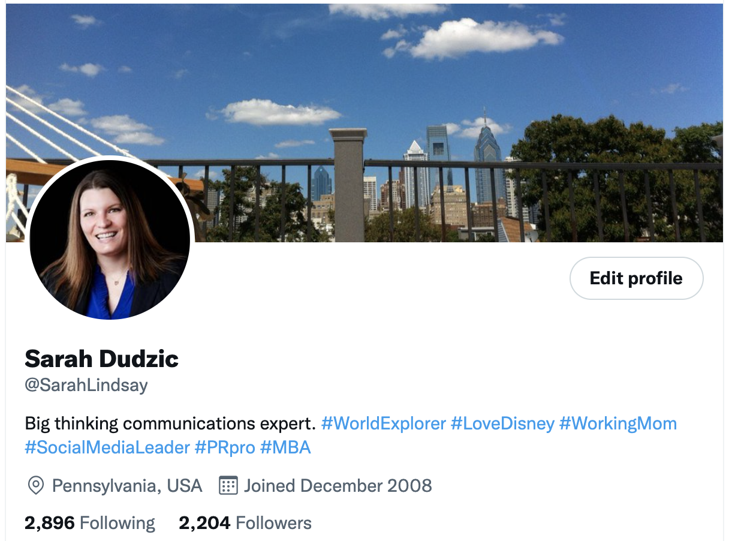
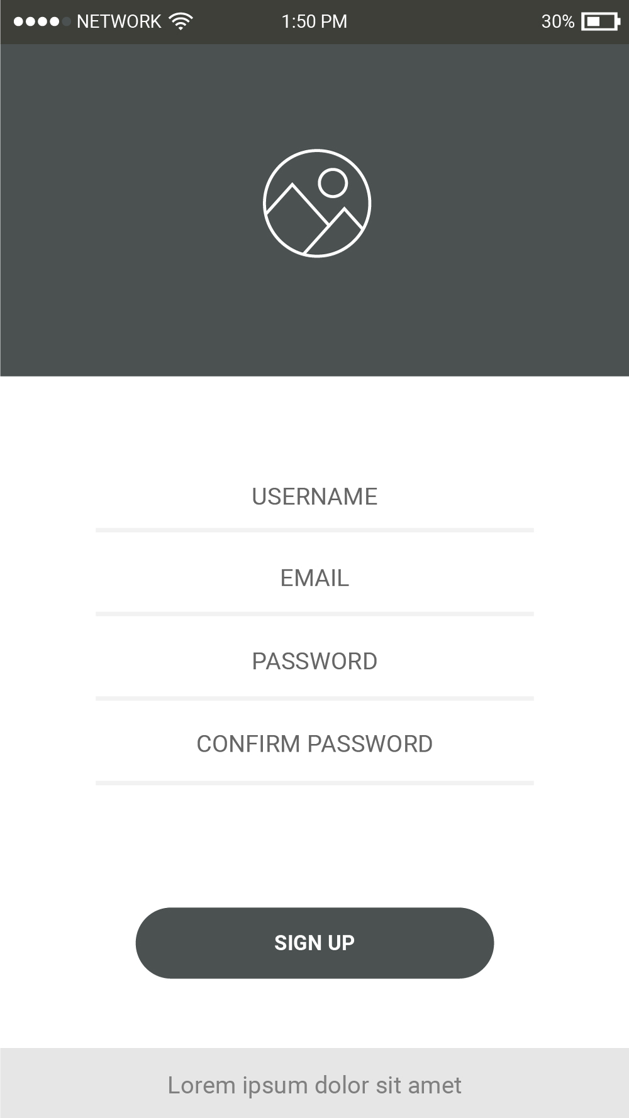
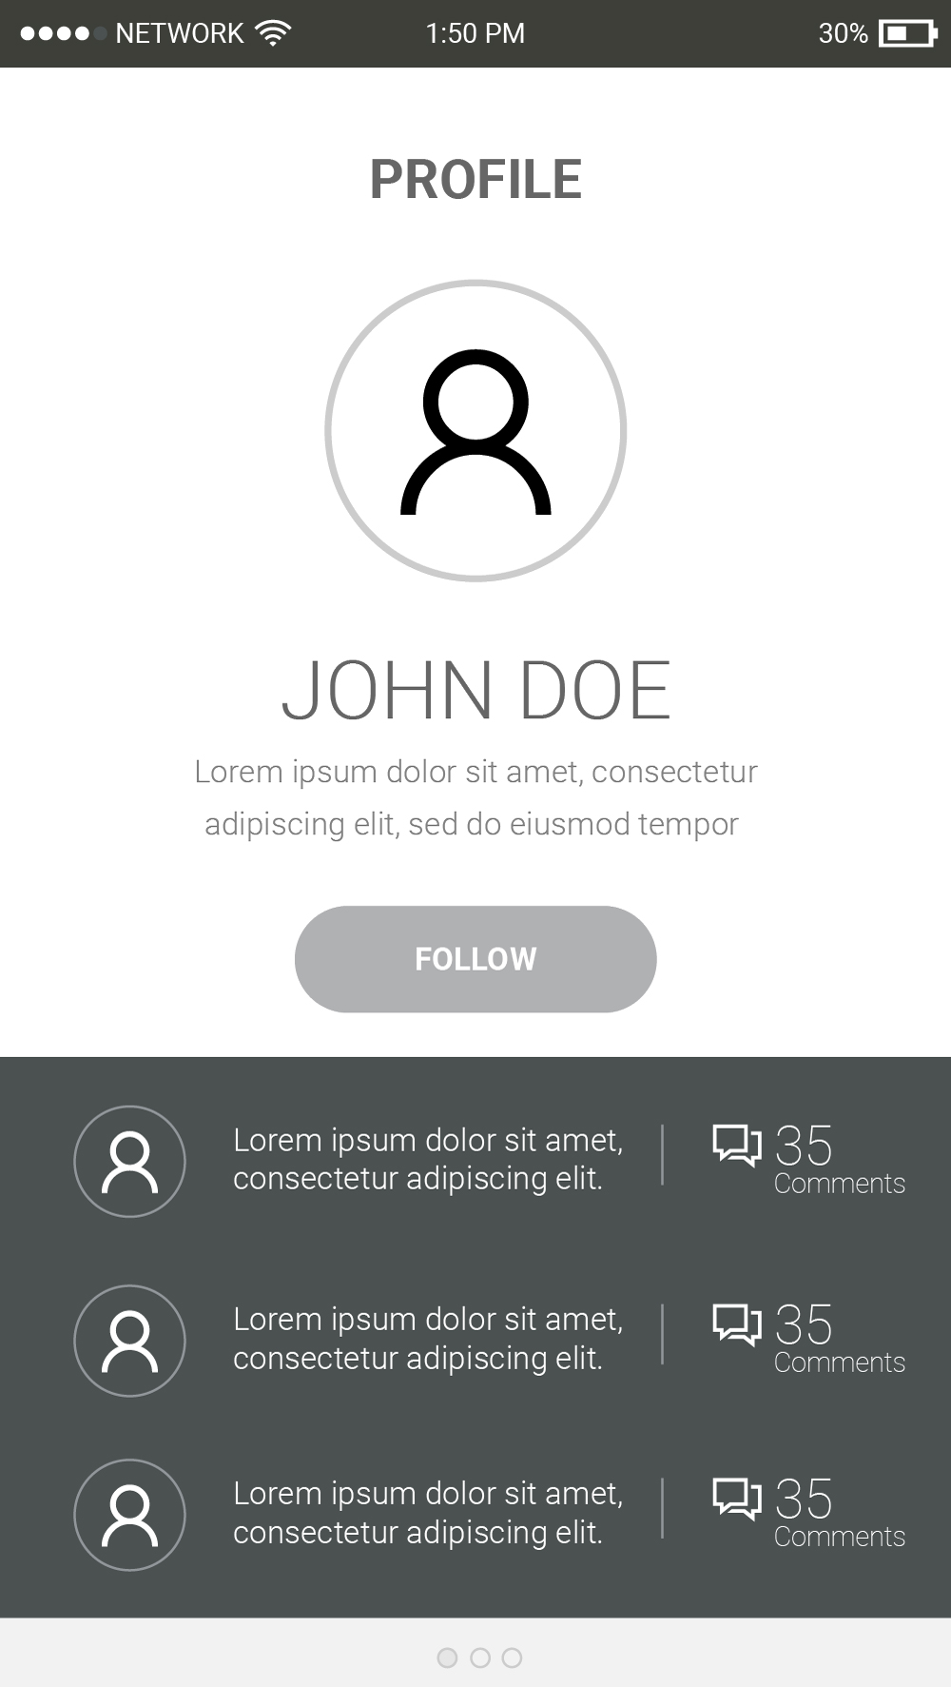
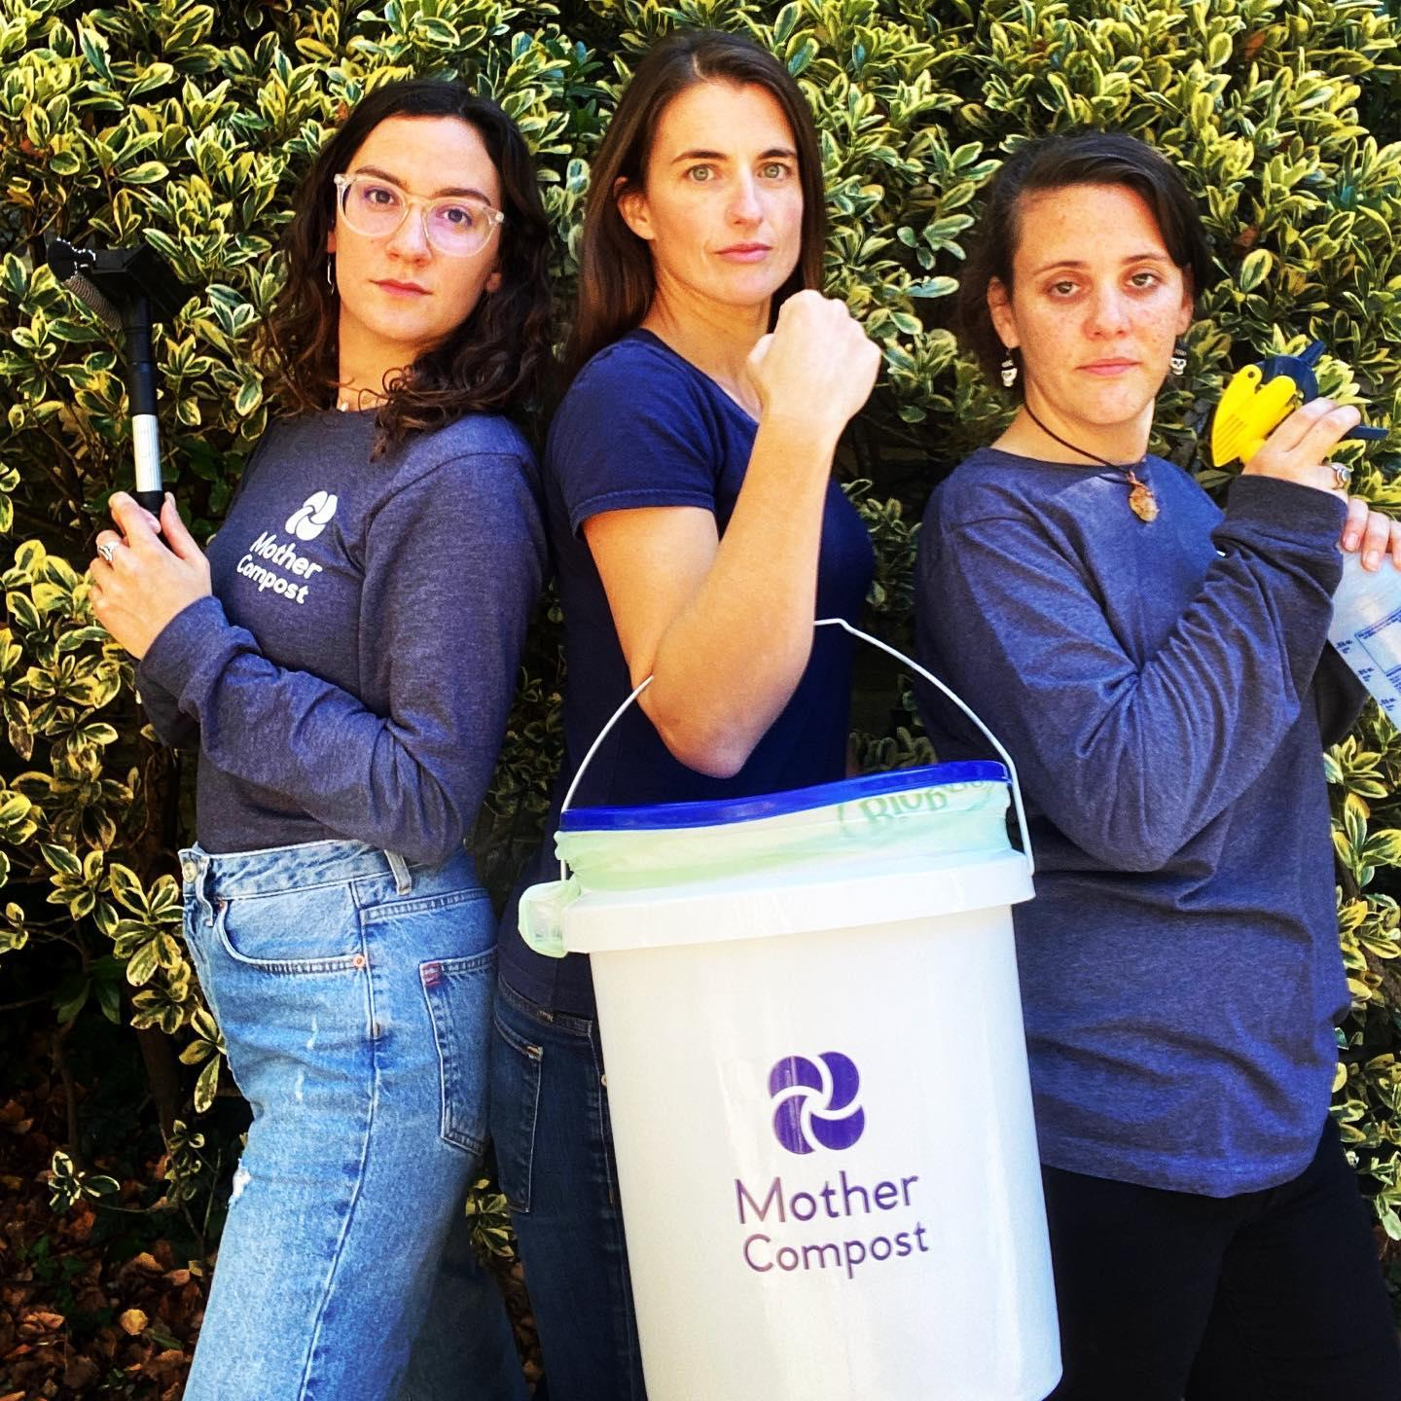
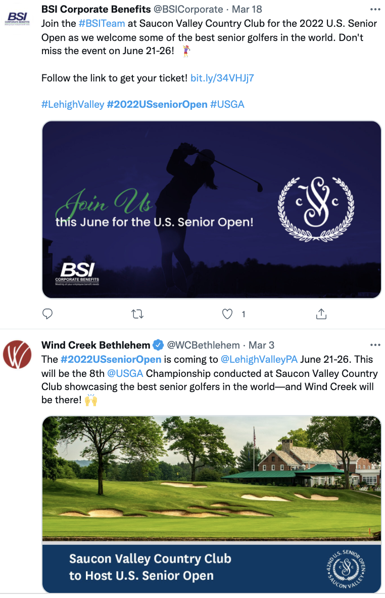
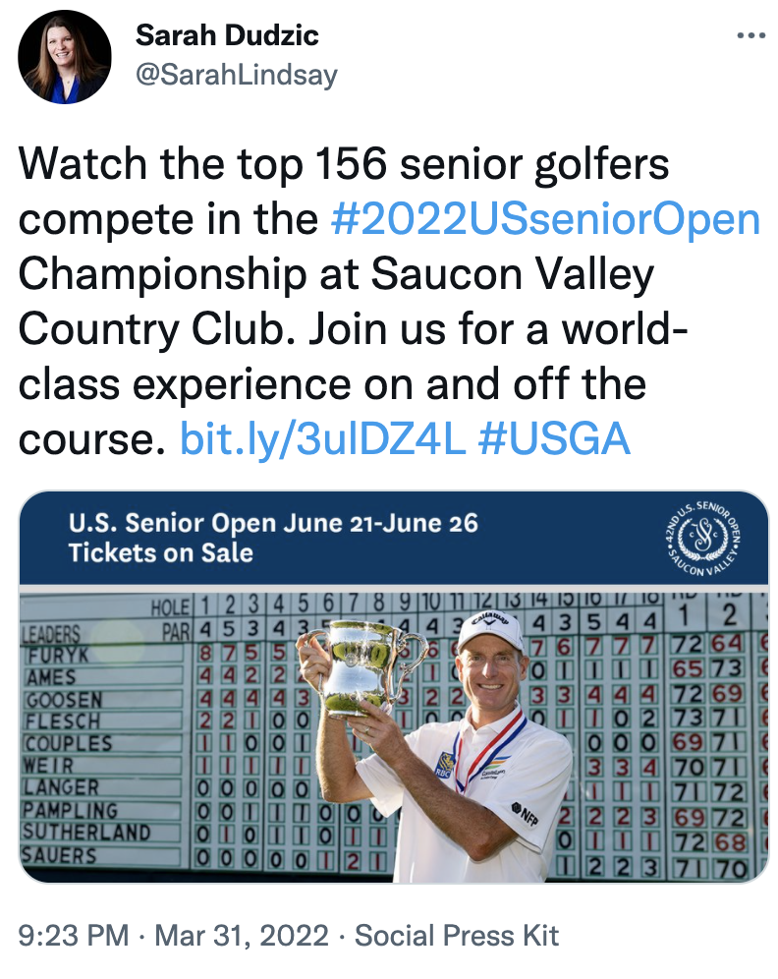
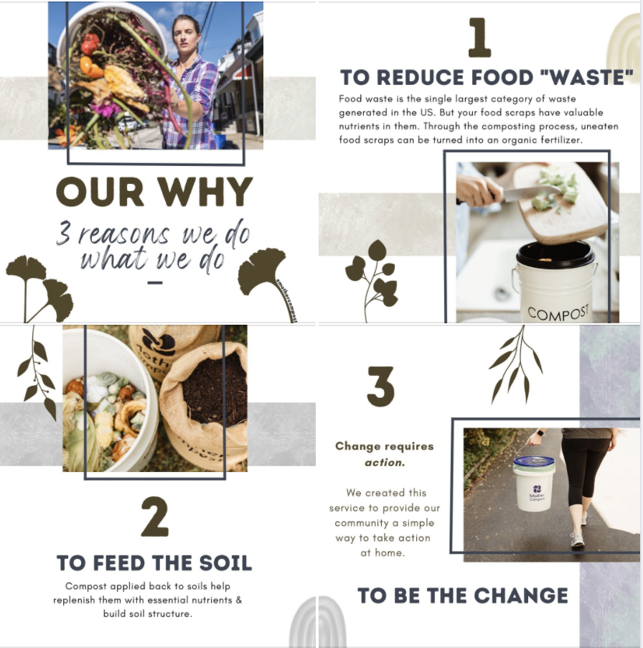
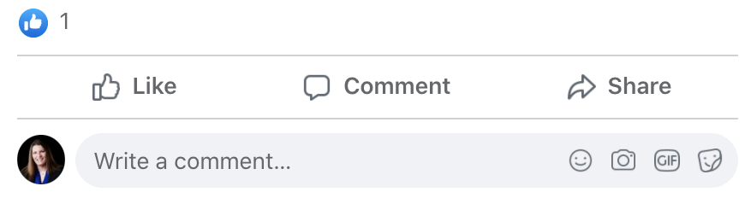
RESULTS
HASHTAG
32
Posts
TWITTER
6 total posts resulting in 6 likes and 6 retweets.
We make composting simple and easy. Be part of the Main Line change – think more about how to waste less.
FACEBOOK
11 total posts resulting in 26 likes and 6 shares.
NAME
I’d like more information about composting.
I’d like more information on educational sessions.
INSTAGRAM
9 posts resulting in 46 video views and 71 likes.
LINKEDIN
6 post resulting in 70 likes and 3 comments.

Slide 6
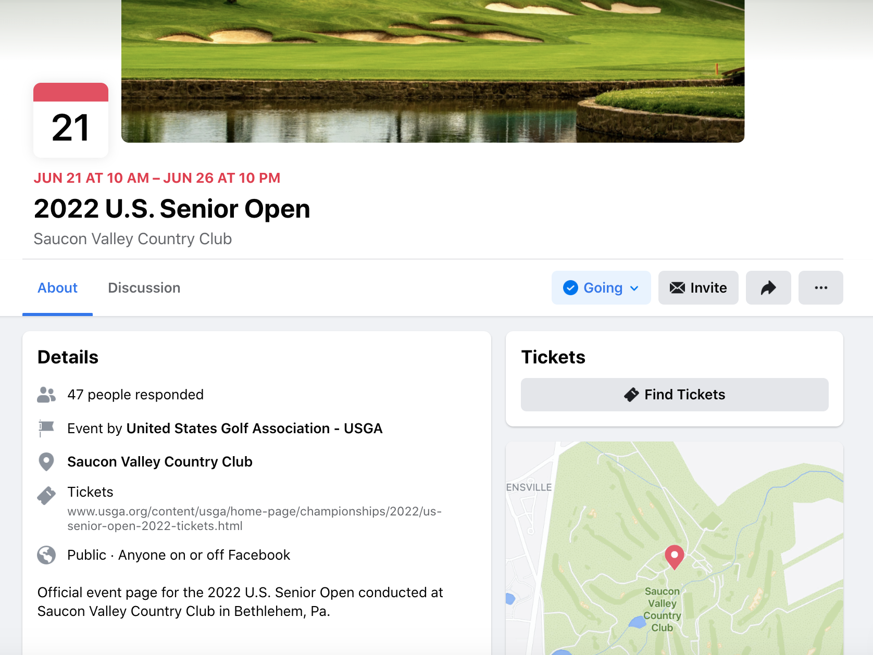
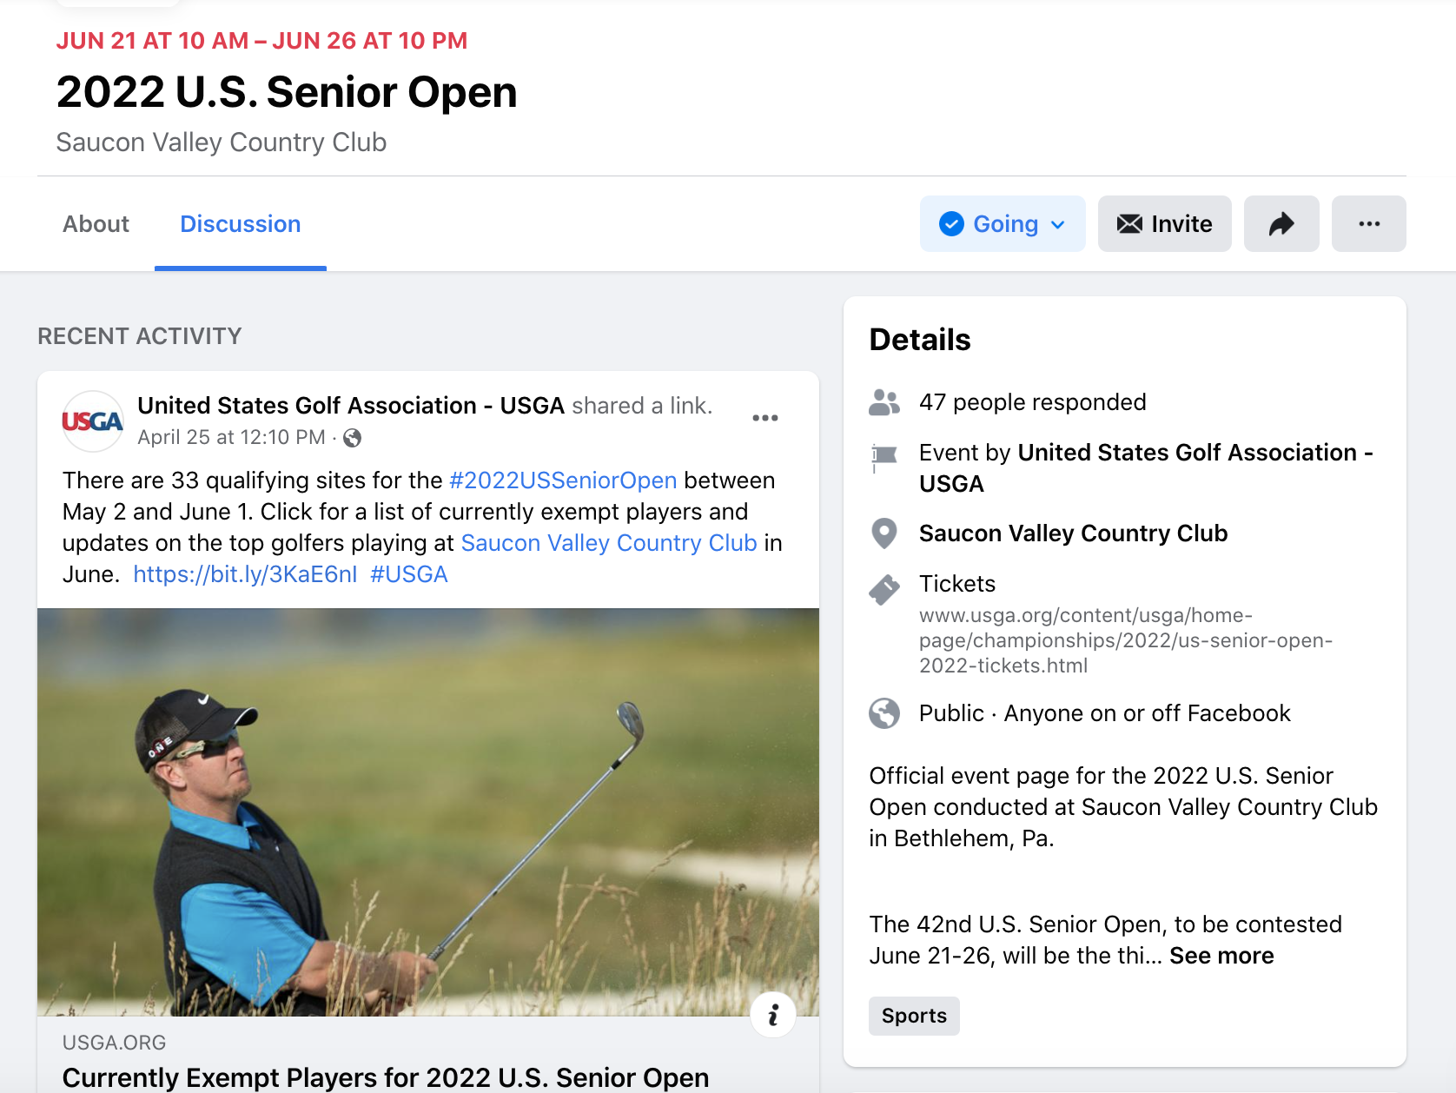
RESULTS
FACEBOOK EVENT PAGE
REACH
2,850 unique individuals 18% of total reach is men 35-44
RESPONSES
50 (27 going, 23 interested)
TICKET CLICKS
0
POST ENGAGEMENT
34 (25 Likes, 6 Comments, 3 Shares)
Notes:
https://fb.me/e/3niBp4JYF

Slide 7
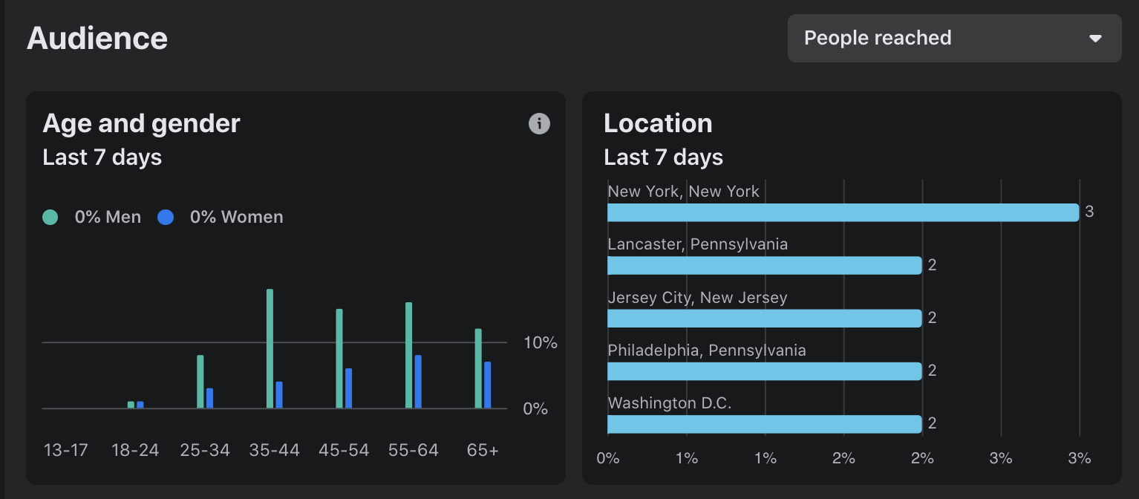
RESULTS
FACEBOOK EVENT PAGE
Notes:
https://fb.me/e/3niBp4JYF

Slide 8

OPTIMIZATION
OUTREACH
Continue influencer identification and outreach.
Create/send out player focused content (in review with USGA)
Engage volunteers to share content
New Ideas

Slide 9
#THANKYOU
Contact
Sarah Dudzic
SeDudzic@gmail.com
610-462-6202

